Slide 1



The title goes here
CMR TECHNICAL CAMPUS UGC AUTONOMOUS Accredited by NBA & NAAC with ‘A’ Grade Approved by AICTE, New Delhi and JNTU, Hyderabad Kandlakoya(V), Medchal Road, Hyderabad-501401, Telangana
Department of Computer Science and Engineering Developing an NLP Model for Efficient Summarization of Legal and Financial Documents
By BATCH 3
G.MANISHA 217R1A0525
M.SACHIN 217R1A0535
B.GOVARDHAN 217R1A0514
BATCH NO : 3
G. Manisha 217R1A0525
M. Sachin 217R1A0535
B. Govardhan 217R1A0514
Under the Guidance of
DR.K.Maheswari
(Associate Professor)
Name

Slide 2
CONTENTS
Introduction and overview of the project (Abstract).
Existing system.
Disadvantage
Proposed system.
Advantages
Hardware and software requirements.
Novelty of your Project
Architecture
Modules
UML Diagrams (Use case Diagram, Class Diagram, Sequence Diagram and Activity Diagram)
Sample Code
Results
Conclusion
Future Scope
References
Git hub Link

Slide 3
INTRODUCTION AND ABSTRACT
PROBLEM
The growing volume of legal and financial documents creates a need for efficient summarization tools.
These documents are often long, complex, and filled with specialized terminology.
SOLUTION
This project proposes an NLP model to automatically summarize legal and financial documents.
The model uses transformer architectures and deep learning to create concise, coherent
summaries while retaining key insights.

Slide 4
Current Summarization Methods:
Extractive Summarization:
Selects key sentences/phrases directly from the source text.
Uses methods like TF-IDF, SVM, and neural networks for identifying relevant content.
Limitations: Lacks coherence and fluidity, as it only extracts segments without contextual integration.
Abstractive Summarization:
Generates summaries by rephrasing and integrating information.
Transformer-based models (e.g., BERT, GPT) improve coherence by understanding context and semantics.
Challenges: Struggles with the complexities of legal and financial texts, often overlooking critical details or misinterpreting information.
EXISTING SYSTEM

Slide 5
Lack of Coherence and Fluidity:
Extractive methods often produce disjointed summaries by directly selecting sentences from the text.
Results in summaries that lack seamless narrative flow, making it harder for users to understand the key insights.
Inadequate Handling of Complex Language & Terminology:
Legal and financial texts contain specialized language and complex structures.
Non-domain-specific models may struggle to accurately interpret legal clauses or financial data, leading to misinterpretation and critical detail omissions.
Disadvantages of Existing Systems

Slide 6
PROPOSED SYSTEM
Overview:
Transformer-based architecture, fine-tuned on domain-specific datasets for legal and financial documents.
Hybrid approach integrating extractive and abstractive summarization methods.
Ensures summaries that are concise, coherent, contextually accurate, and legally sound.
Key Features:
Enhanced Numerical Data Interpretation:
Accurately summarizes financial metrics alongside textual content.
Advanced algorithms to interpret and contextualize financial data.
Legal Accuracy:
Specialized legal language models preserve the integrity of legal clauses and terminology.
Security & Compliance:
Advanced encryption and compliance with data protection regulations to ensure privacy and security of sensitive information.

Slide 7
Proposed System: Step-by-Step Process
Data collection & Preprocessing
Collect and preprocess a domain specific corpus of legal and financial texts.
Model Training
Fine tune transformer model to learn legal and financial terminology and document structure.
Hybrid Summarization
Combine extractive and abstraction techniques to generate accurate and contextually sound summaries.
Numerical & Legacy Accuracy
Interpret financial data and pressure legal clauses intergrity for acccurate and contextually sound summaries.
Customization Options
Provide users with flexibility to adjust summary detail and focus based on needs.
Security and Privacy
Ensure data encryption and compilances with privacy regulation for sensitive document handling.

Slide 8
Advantages of the Proposed System
Better Coherence and Flow
Combines extractive and abstractive methods for clearer, more fluid summaries.
Ensures seamless narrative flow, making key insights easier to understand.
Accurate Handling of Complex Terminology
Fine-tuned on legal and financial texts to understand specialized terms.
Produces summaries that retain critical details and accurately represent the original content.

Slide 9
System Requirements
Category | Specification
Hardware Requirements
Processor | Intel i3 or above
RAM | 8 GB (minimum)
Hard Disk | 512 GB
Keyboard | Standard Windows Keyboard
Mouse | Two or Three Button Mouse
Monitor | SVGA
Software Requirements
Operating System | Windows 7 Ultimate
Coding Language | Python
Front-End | Python
Back-End | Django-ORM
Designing | HTML, CSS, JavaScript
Database | MySQL

Slide 10
NOVELTY OF THE PROJECT
Hybrid Summarization
Combines extractive and abstractives methods for accurate, coherent summaries.
Domain-Specific Training
Fine Tuned on legal and financial texts to handle complex terminology.
Numerical Data Integration
Summaries financial metrices alongside text for complete insights.
Legal Acccuracy
Ensure legal clauses and terminology are preserved in summaries.
Customizable Summaries
Allow users to adjust summary length and focus.
Data Security
Implements advanced encryption and ensures data privacy.

Slide 11
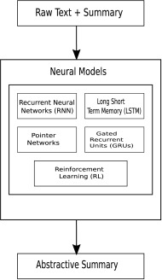
SYSTEM ARCHITECTURE

Slide 12
Modules
New User Sign-up
Allows users to register and create an account within the application.
User Login
Provides access for users to log in after signing up.
Train NLP Summary Model
Trains the NLP model on legal datasets and allows users to perform predictions to evaluate precision and other metrics.
Generate Summary
Users can input sample text, and the system will generate summaries using the trained NLP model.

Slide 13
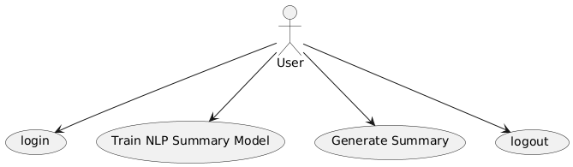
UML DIAGRAMS

Slide 14
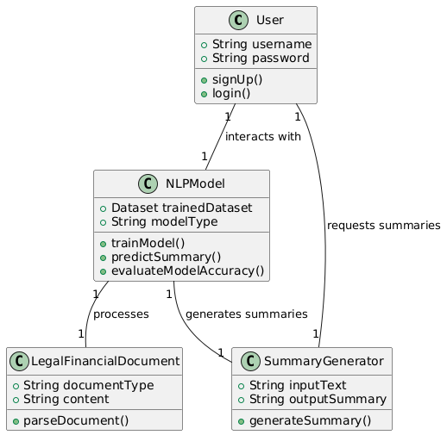
CLASS DIAGRAM

Slide 15
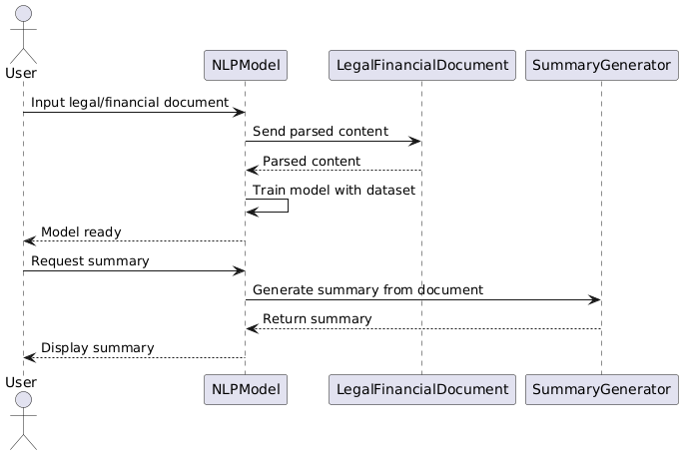
SEQUENCE DIAGRAM

Slide 16
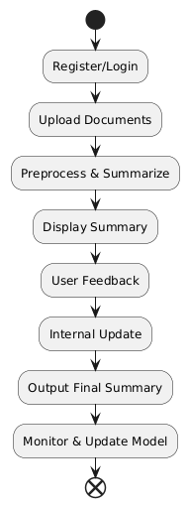
ACTIVITY DIAGRAM

Slide 17
SAMPLE CODE
from django.shortcuts import render
from django.template import RequestContext
from django.contrib import messages
import pymysql
from django.http import HttpResponse
import json
from string import punctuation
from nltk.corpus import stopwords
import nltk
from nltk import tokenize
from heapq import nlargest
from rouge_score import rouge_scorer
import matplotlib.pyplot as plt
from transformers import pipeline
import pandas as pd
import io
import base64
global uname
stop_words = set(stopwords.words('english'))
#function to summarize essay
def summarize(essay, threshold):
word_frequencies = {}
tokens = essay.split(" ")
for word in tokens:

Slide 18
if word.lower() not in stop_words:
if word not in word_frequencies.keys():
word_frequencies[word] = 1
else:
word_frequencies[word] += 1
max_frequency = max(word_frequencies.values())
for word in word_frequencies.keys():
word_frequencies[word] = word_frequencies[word]/max_frequency
sentence_tokens = tokenize.sent_tokenize(essay)
sentence_scores = {}
for sent in sentence_tokens:
words = sent.split(" ")
for word in words:
if word.lower() in word_frequencies.keys():
if sent not in sentence_scores.keys():
sentence_scores[sent] = word_frequencies[word.lower()]
else:
sentence_scores[sent] += word_frequencies[word.lower()]
select_length = int(len(sentence_tokens)*threshold)
summary = nlargest(select_length, sentence_scores, key = sentence_scores.get)
final_summary = [word for word in summary]
summary = ' '.join(final_summary)
return summary
file = open('Dataset/tldrlegal_v1.json')
data = json.load(file)
file.close()
scorer = rouge_scorer.RougeScorer(['rouge1', 'rougeL'], use_stemmer=True) #calculate rouge scrore between test and predicted
precision = 0
recall = 0
fscore = 0

Slide 19
pre = []
rec = []
fsc = []
j = 0
original_data = None
original_sum = None
for key, value in data.items():
text = value['original_text']
summary = value['reference_summary']
if j == 2:
original_data = text
original_sum = summary
nlp_summary = summarize(text, 0.95)
scores = scorer.score(summary, nlp_summary)
score = scores['rouge1']
#print(score)
p = score[0]
r = score[1]
f = score[2]
if p > precision:
precision = p
if r > recall:
recall = r
if f > fscore:
fscore = f
j += 1
pre.append(precision)
rec.append(recall)
fsc.append(fscore)
transformer = pipeline("summarization")
predict = transformer(original_data)[0]['summary_text']
scores = scorer.score(original_sum, predict)
score = scores['rouge1']
p = score[0]
r = score[1]
})
def SignupAction(request):
if request.method == 'POST':
username = request.POST.get('t1', False)
password = request.POST.get('t2', False)
contact = request.POST.get('t3', False)
email = request.POST.get('t4', False)
address = request.POST.get('t5', False)
status = 'none'
con = pymysql.connect(host='127.0.0.1',port = 3306,user = 'root', password = 'root', database = 'summary',charset='utf8')
with con:
cur = con.cursor()
cur.execute("select username from signup where username = '"+username+"'")
rows = cur.fetchall()
for row in rows:
if row[0] == email:
status = 'Given Username already exists'
break
if status == 'none':
db_connection = pymysql.connect(host='127.0.0.1',port = 3306,user = 'root', password = 'root', database = 'summary',charset='utf8')
db_cursor = db_connection.cursor()
student_sql_query = "INSERT INTO signup(username,password,contact_no,email_id,address) VALUES('"+username+"','"+password+"','"+contact+"','"+email+"','"+address+"')"
db_cursor.execute(student_sql_query)
db_connection.commit()
print(db_cursor.rowcount, "Record Inserted")
if db_cursor.rowcount == 1:
status = 'Signup Process Completed'
context= {'data':status}
return render(request, 'Signup.html', context)
def UserLoginAction(request):
if request.method == 'POST':
global uname
option = 0
username = request.POST.get('username', False)
password = request.POST.get('password', False)
con = pymysql.connect(host='127.0.0.1',port = 3306,user = 'root', password = 'root', database = 'summary',charset='utf8')
with con:

Slide 20
f = score[2]
pre.append(p)
rec.append(r)
fsc.append(f)
def TrainNLP(request):
if request.method == 'GET':
global precision, recall, fscore
output = ''
output+='<table border=1 align=center width=100%><tr><th><font size="" color="black">Algorithm Name</th><th><font size="" color="black">Precision</th>'
output+='<th><font size="" color="black">Recall</th><th><font size="" color="black">FMEASURE</th></tr>'
algorithms = ['NLP Summary', 'Transformer Summary']
output+='<tr><td><font size="" color="black">'+algorithms[0]+'</td><td><font size="" color="black">'+str(pre[0])+'</td><td><font size="" color="black">'+str(rec[0])+'</td><td><font size="" color="black">'+str(fsc[0])+'</td></tr>'
output+='<tr><td><font size="" color="black">'+algorithms[1]+'</td><td><font size="" color="black">'+str(pre[1])+'</td><td><font size="" color="black">'+str(rec[1])+'</td><td><font size="" color="black">'+str(fsc[1])+'</td></tr>'
output+= "</table></br></br>"
df = pd.DataFrame([['NLP Summary','Precision',pre[0]],['NLP Summary','Recall',rec[0]],['NLP Summary','F1 Score',fsc[0]],
['Transformer Summary','Precision',pre[1]],['Transformer Summary','Recall',rec[1]],['Transformer Summary','F1 Score',fsc[1]],
],columns=['Algorithms','Metrics','Value'])
df.pivot_table(index="Algorithms", columns="Metrics", values="Value").plot(kind='bar', figsize=(5, 3))
plt.title("All Algorithms Performance Graph")

Slide 21
cur = con.cursor()
cur.execute("select * FROM signup")
rows = cur.fetchall()
for row in rows:
if row[0] == username and row[1] == password:
uname = username
option = 1
break
if option == 1:
output = "Welcome "+uname
context= {'data':output}
return render(request, 'UserScreen.html', context)
else:
context= {'data':'Invalid login details'}
return render(request, 'UserLogin.html', context)
def GenerateSummary(request):
if request.method == 'GET':
return render(request, 'GenerateSummary.html', {})
def GenerateSummaryAction(request):
if request.method == 'POST':
global uname
textdata = request.POST.get('t1', False)
summary = summarize(textdata, 0.3)
'''
output = '<table align="center" width="80">'
output += '<tr><td><font size="3" color="black">Input&nbsp;Text</b></td><td><textarea name="t1" rows="15" cols="80">'+textdata+'</textarea></td></tr>'
output += '<br/><br/><tr><td><font size="3" color="black">Generated&nbsp;Summary</b></td><td><textarea name="t2" rows="10" cols="80">'+summary+'</textarea></td></tr>'
output += "</table></br></br></br>"
'''
output = '<p align="justify"><font size="3" style="font-family: Comic Sans MS" color="black">Input Text = '+textdata+'</p><br/>'
output += '<p align="justify"><font size="3" style="font-family: Comic Sans MS" color="black">Generated Summary = '+summary+'</p><br/><br/><br/><br/><br/>'
context= {'data':output}
return render(request, 'UserScreen.html', context)

Slide 22
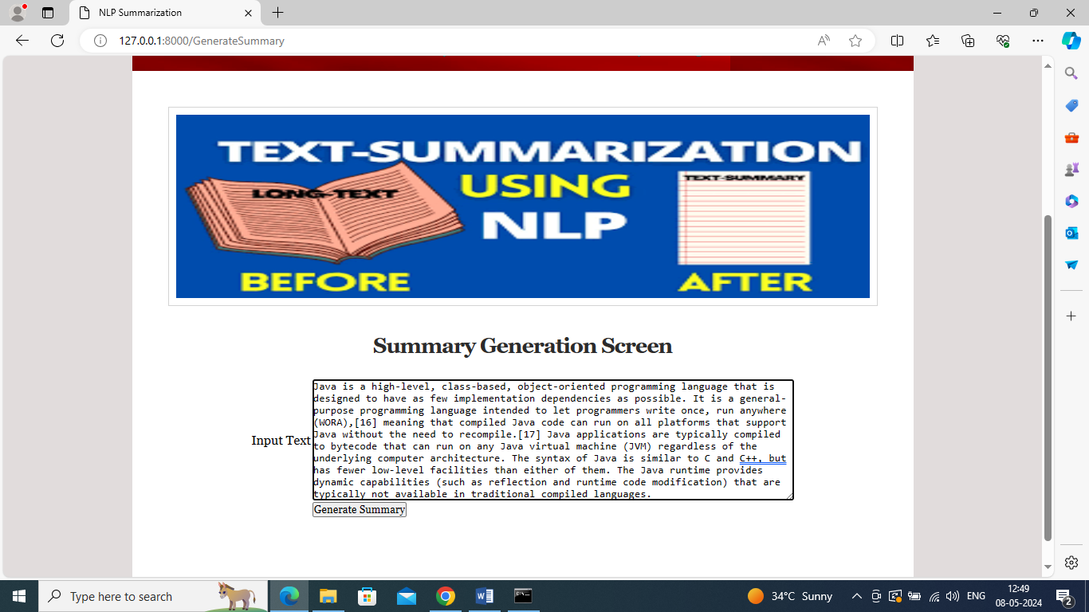
RESULTS
INPUT IMAGE

Slide 23
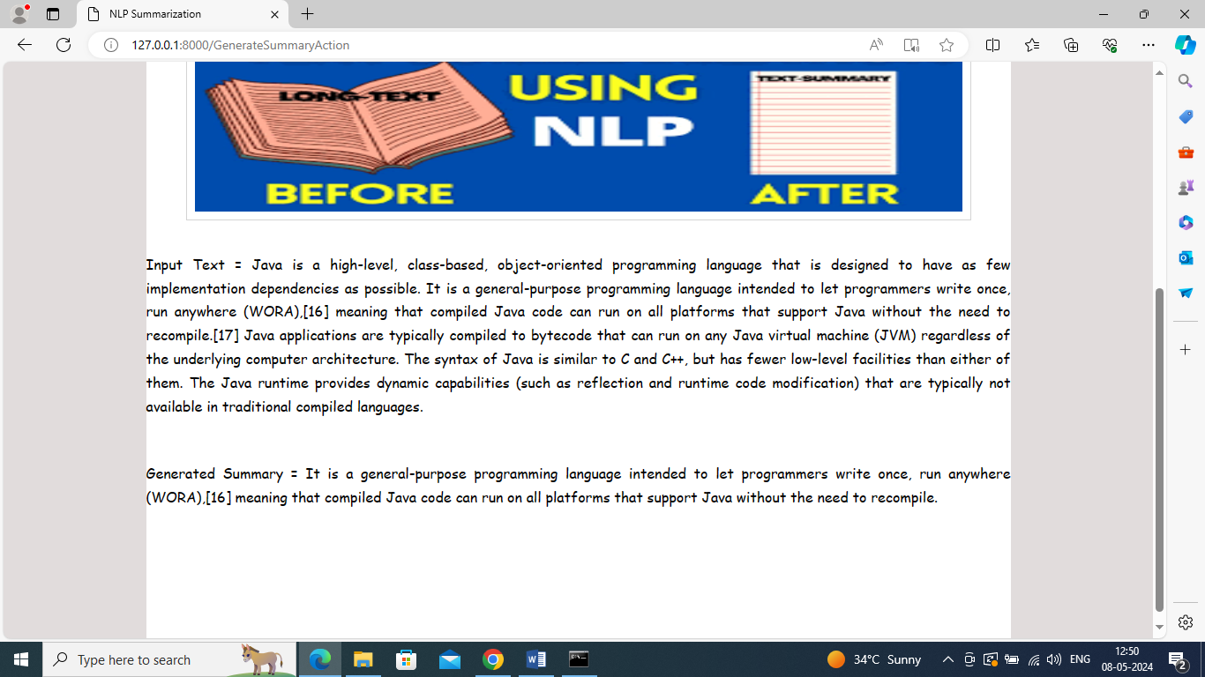
OUTPUT IMAGE

Slide 24
CONCLUSION
NLP models for summarizing legal and financial documents can streamline complex processes, improve efficiency, and reduce errors. By leveraging advanced models like BERT, GPT, or T5, trained on domain-specific data, the tool can provide accurate, context-aware summaries. Customization options for professionals and careful attention to ethical concerns (e.g., data privacy) will ensure usability and reliability, ultimately enhancing decision-making in these sectors.

Slide 25
Future Scope of the Project
Key advancements could include:
Context-Aware Summarization: Custom summaries based on user needs (e.g., risk factors for legal, performance indicators for finance).
Multilingual Capabilities: Summarization across multiple languages to support global operations.
Integration with Document Systems: Automation of workflows, reducing human error.
Applications in Compliance & Monitoring: Automated flagging of discrepancies or non-compliance.
Privacy-Preserving Techniques: Enhanced security in handling sensitive data.

Slide 26
REFERENCES
Reference | Description
1. Sharma, N., & Kumar, V. (2020). Legal Document Summarization using Machine Learning and NLP Techniques. | Focused on summarizing legal documents with extractive and abstractive techniques.
2. Deng, Y., & Liu, Y. (2020). Financial Document Summarization Using Pre-trained Models. | Explores pre-trained models like BERT for summarizing financial documents.
3. Xiao, C., et al. (2020). Financial Document Summarization Based on Pre-trained Language Models and Text Rank. | Combines BERT with Text Rank for financial document summarization.
4. Zheng, W., et al. (2019). A Study of Legal Text Summarization Using BERT. | Focuses on BERT for legal text summarization, addressing complex terminologies.
5. Liu, Y., et al. (2019). Fine-tune BERT for Extractive Summarization. | Uses BERT for summarizing domain-specific texts, including legal and financial documents.
6. Devlin, J., et al. (2019). BERT: Pre-training of Deep Bidirectional Transformers for Language Understanding. | BERT's bidirectional attention mechanism for summarization tasks.
7. Vaswani, A., et al. (2017). Attention Is All You Need. | Introduces the Transformer architecture, pivotal in NLP summarization tasks.
8. Paulus, R., Xiong, C., & Socher, R. (2018). A Deep Reinforced Model for Abstractive Summarization. | Uses reinforcement learning to improve abstractive summaries.

Slide 27
GitHub Link

Slide 28
THANKYOU
BY BATCH 3
g. mANISHA(217R1A0525)
M. SACHIN(217R1A0535)
b. GOVARDHAN(217R1A0515)
Text

